Slide 1

Combating Modern Slavery in the Supply Chains through Technology
Lukas Lücke, Rishal Fiona, Zuriati Balian, Marianna Vallazza, Nina Niinivirta
Hack’n’lead - Zurich, 01.-02.11.2019

Slide 2
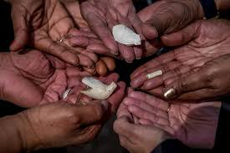
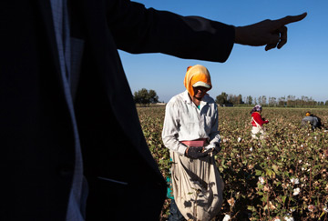
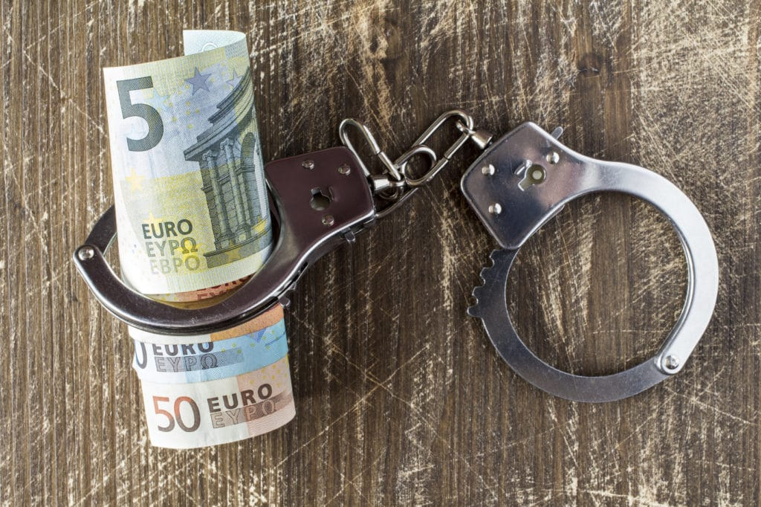
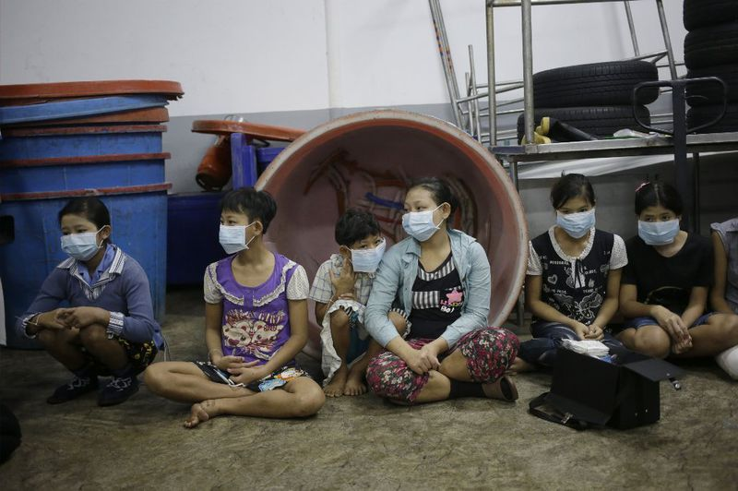
Imagine...
Notes:
Think about how many times you found yourself in a situation where something you saw or heard did not feel right...but did not know what to do/ how to help..

Slide 3
Notes:
Rishal: Do you remember about my neighbor, who recently moved here from (Brazil)? I noticed she’s working very long hours and looks exhausted. The other day she also tried to tell me something about not having received her salary last month, I wanted to ask more, but she doesn’t speak English that well, so I could not find out much else. I am seriously worried for her, Iwould like to help! But how...

Slide 4
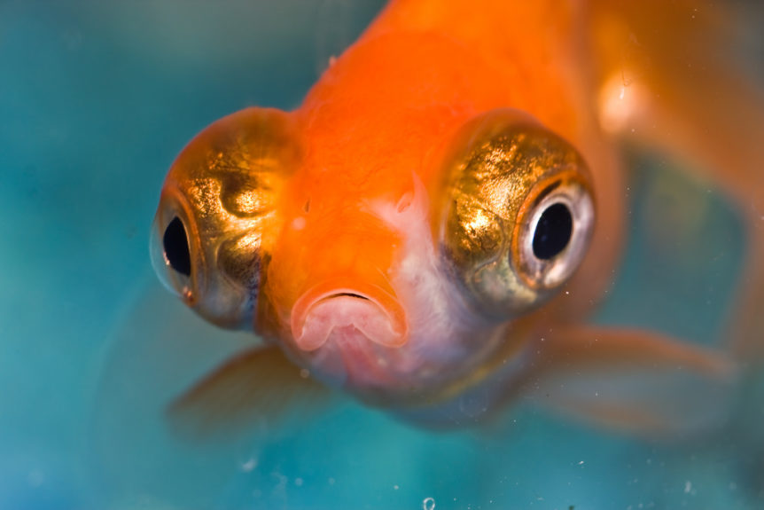
Notes:
Lukas: That sounds fishy (can we show a fish?)!

Slide 5
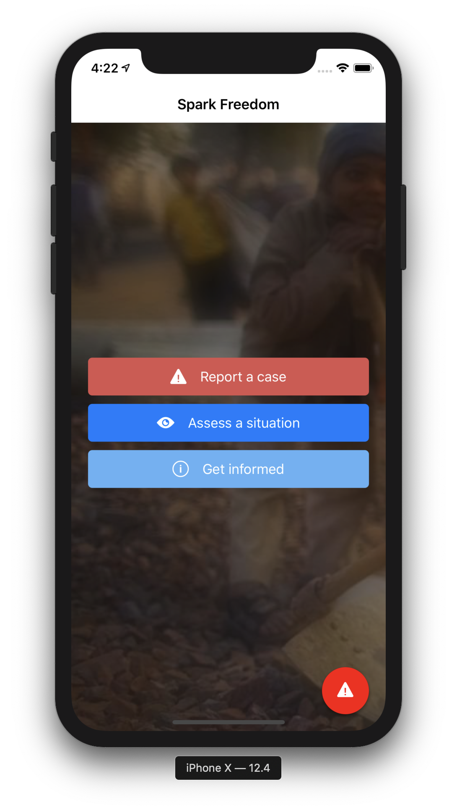
Notes:
I know an app where we could find out if this could be considered forced labor and take action. Look:

Slide 6
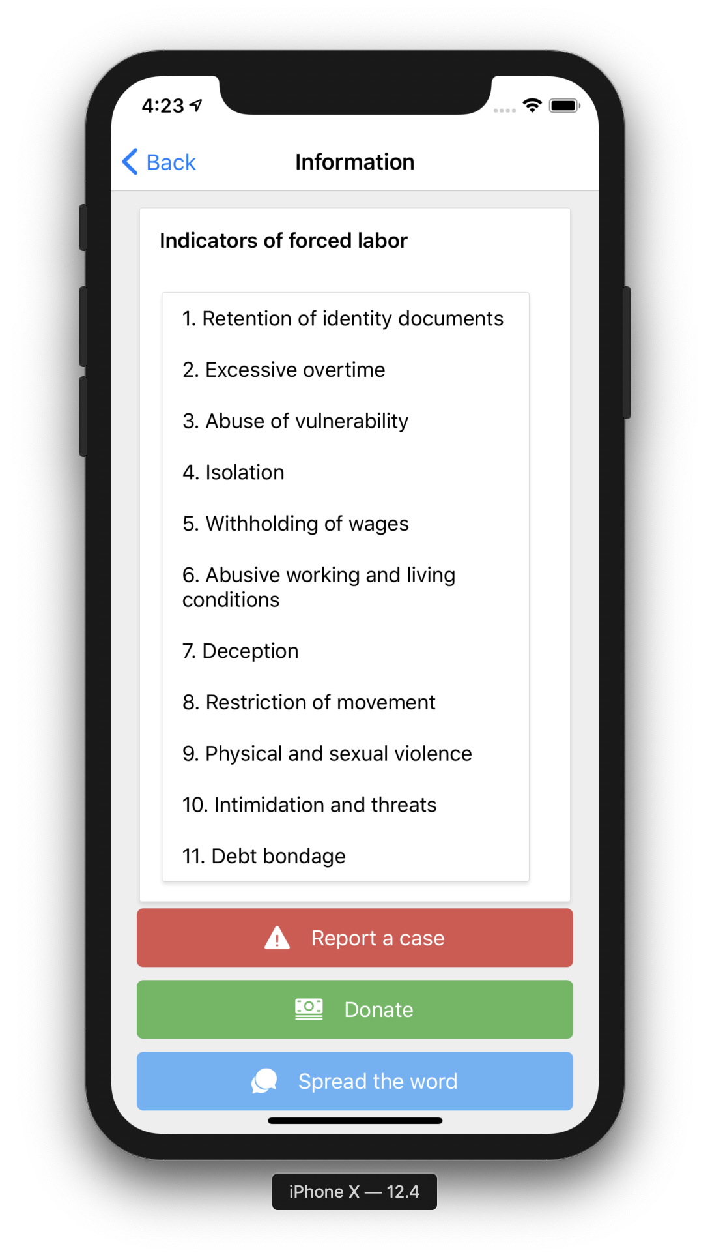
Notes:
- Here there is a questionnaire to assess the situation...read question (answer «true» to excessive labour hours) – true – and... Answer true to withholding money question – «also true» – click on finish....

Slide 7
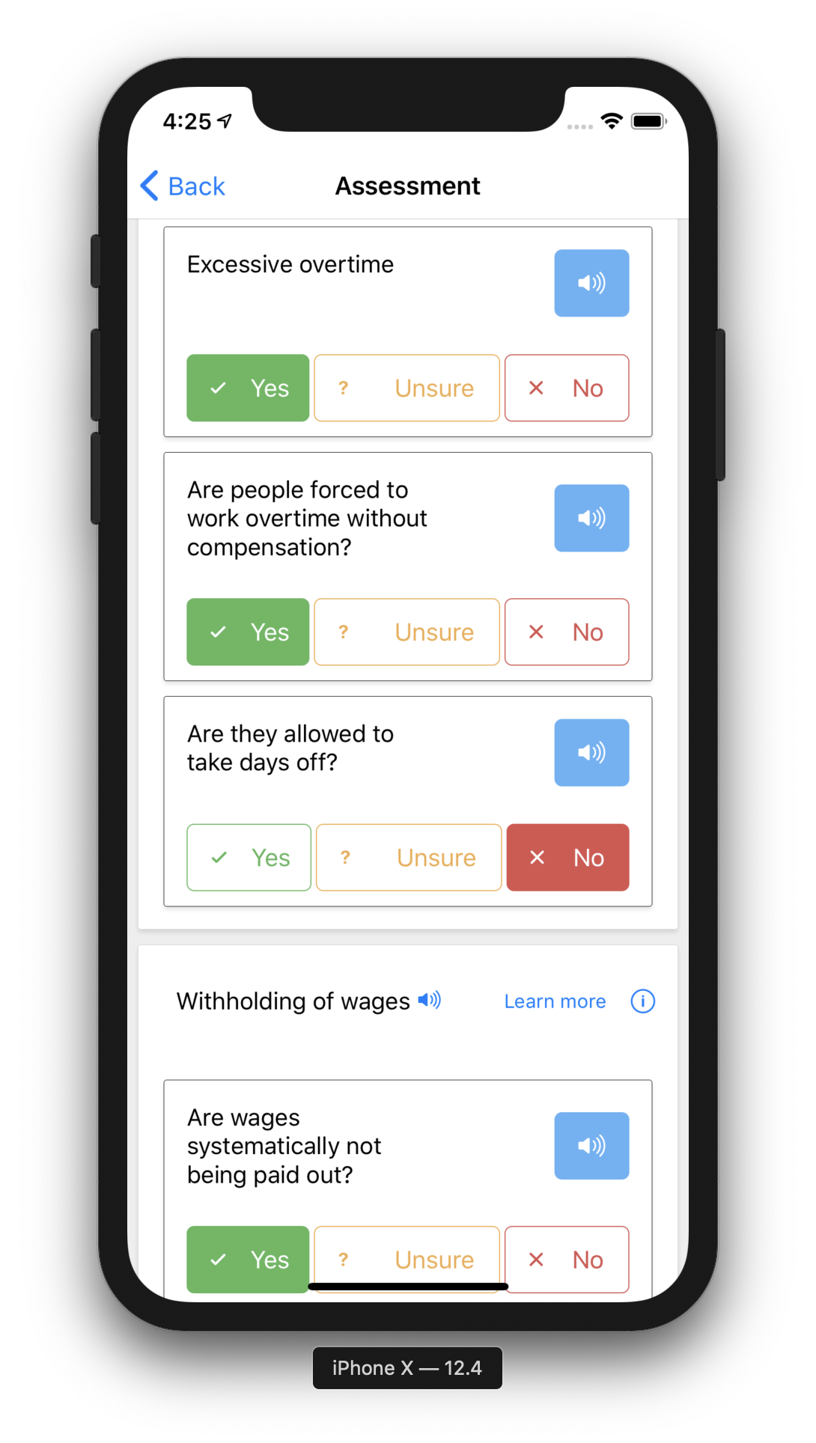
Notes:
- Here there is a questionnaire to assess the situation...read question (answer «true» to excessive labour hours) – true – and... Answer true to withholding money question – «also true» – click on finish....

Slide 8
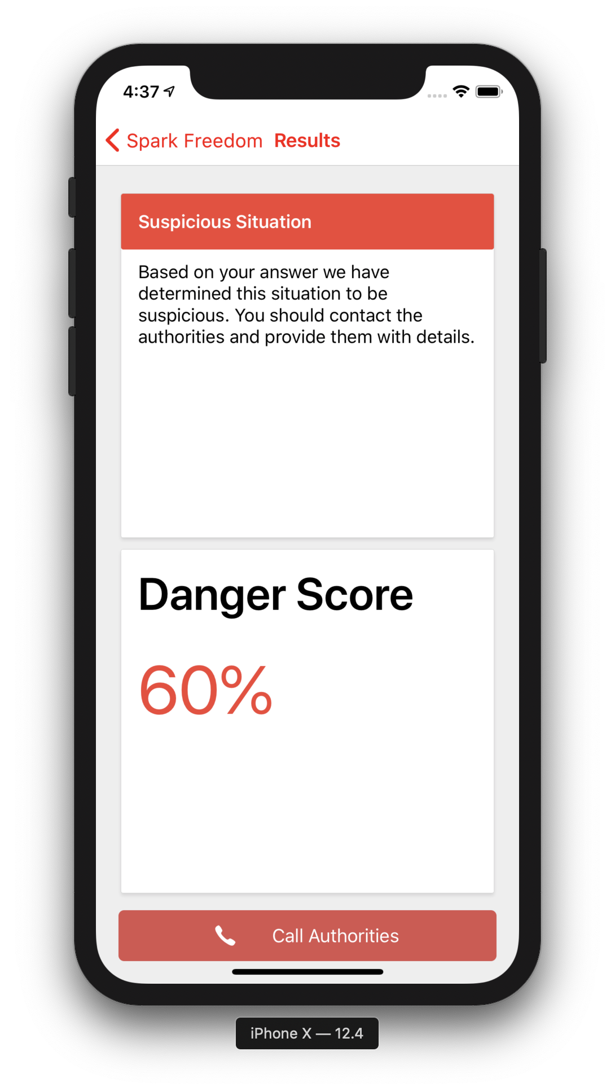
Notes:
Score returned ... Good catch! Let’s report this to the authorities. (Rishal pretending to call)

Slide 9
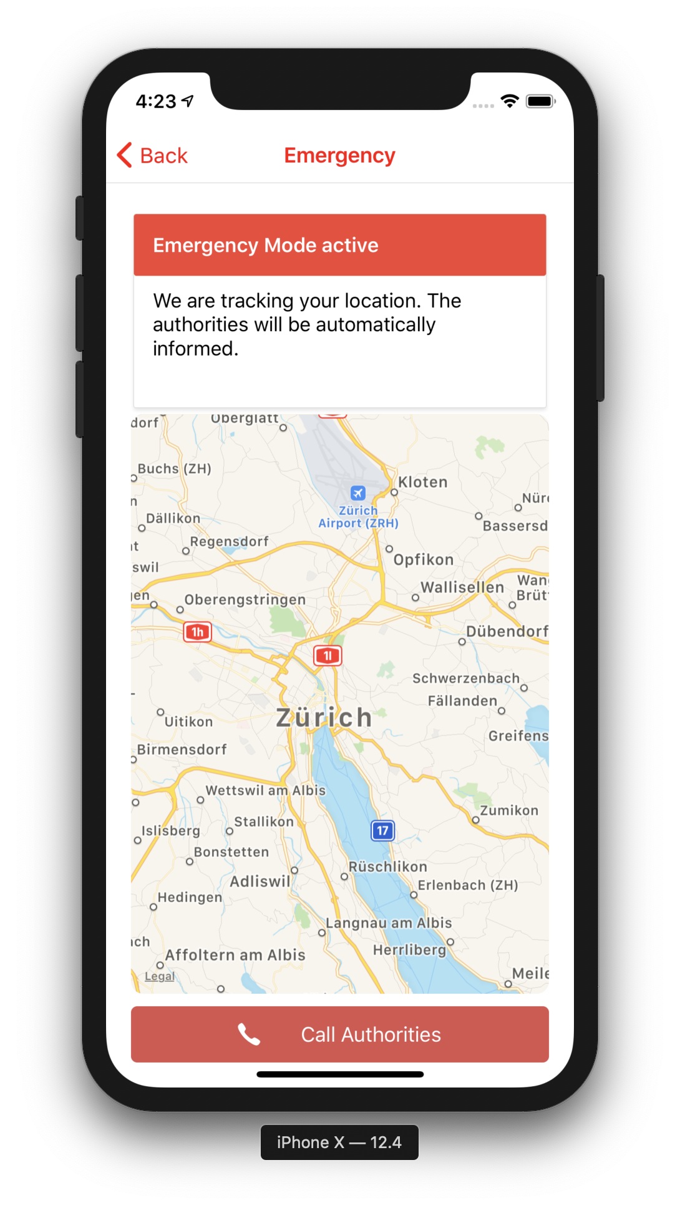
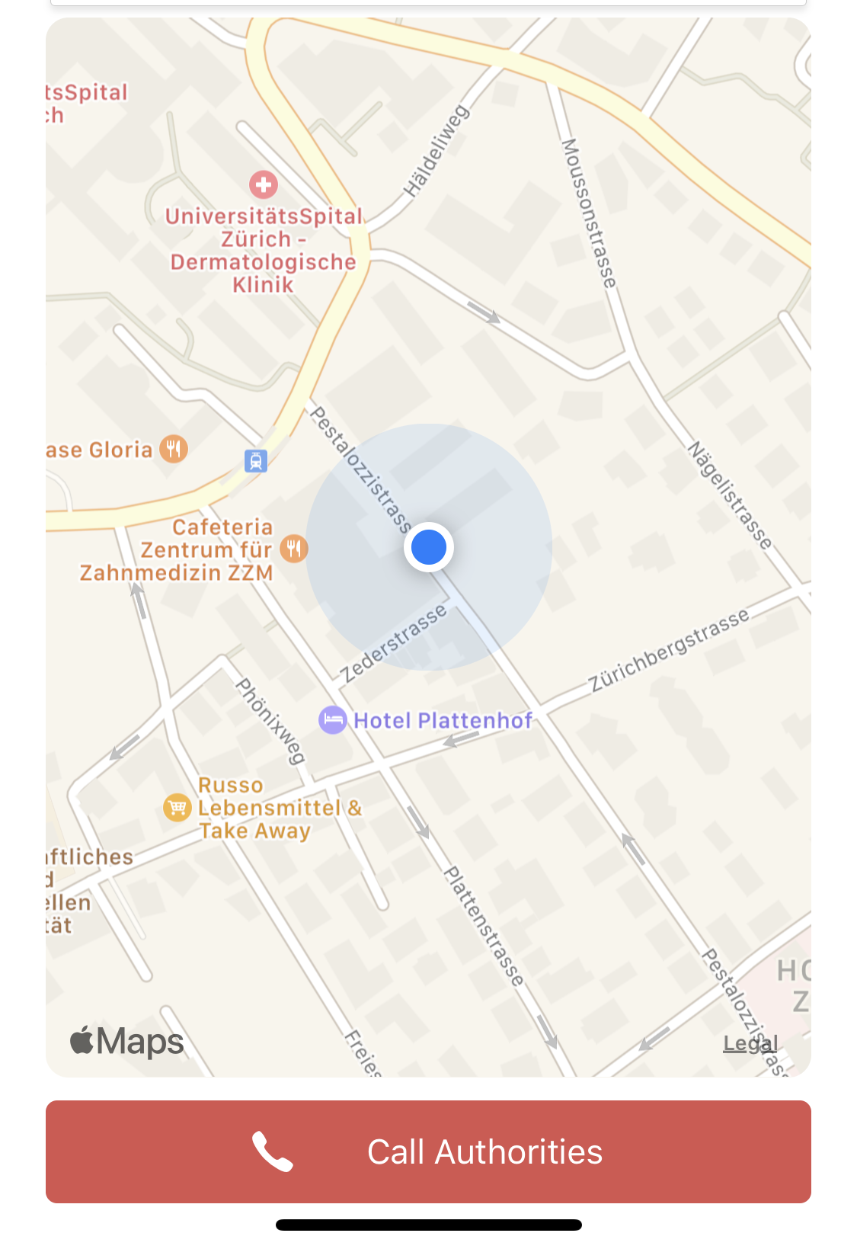
Notes:
Score returned ... Good catch! Let’s report this to the authorities. (Rishal pretending to call)

Slide 10
Educate
Empower
Encourage
Notes:
Marianna: This app is really great! (1) It raises awareness and trains people to recognize the signs of forced labor (2) it gives everyone the power to report their own case or a situation they noticed, directly and anonimously (3) and it even comes with a text to speech functionality making it accessible for people speaking different languages!
I am convinced that it will ultimately increase the number of reported cases!

Slide 11
Spark freedom! Educate, empower, encourage
Notes:
Thanks a lot for your attention...for further questions feel free to reach out to us!

